Slide 1
Security Controls in Shared Source Code Repositories
Stella Kemp
C380
Bellavue University
Professor Darren O
Enhancing Code Security through Strategic Integration and Collaborative Practices

Slide 2


The Importance of Centralized Security Integration
The shared source code repository is recognized as one of the most powerful mechanisms to convert local discoveries and learnings into global improvements across an entire organization.
Security Goals for the Repository:
1. Shift Security Left: Integrate security objectives into the daily work of Dev and Ops early in the development lifecycle.
2. Encode Knowledge: Transform organizational knowledge, standards, and security expertise into an executable form that is easy to reuse, rather than remaining in documents.
3. Ensure Compliance: Create automated controls and artifacts to provide assurance around the integrity and confidentiality of services and data, aiding compliance efforts.
This approach allows Infosec to increase safety and security while maintaining developer and operational productivity!

Slide 3
Best Practice One : Establish a Single Source of Truth
Organizations should operate a single, shared source code repository for the entire organization.
The repository serves as the single repository of truth, ensuring that the version used for development matches the version deployed to production.
Repository Content | Security Significance
Code Libraries Services | Provides easy access to authentication, authorization, logging, and other security services.
Configurations & Standards | Holds security-specific configuration settings (e.g., password hashing, key lengths, OS hardening guides) for application stacks.
Environment Artifacts | Contains base images or cookbooks for OS/infrastructure that are in a known, secure, and risk-reduced state.
Tools & Toolchains | Contains the automated security toolchain (e.g., testing tools, deployment pipeline scripts) to influence Dev/Ops daily work.

Slide 4
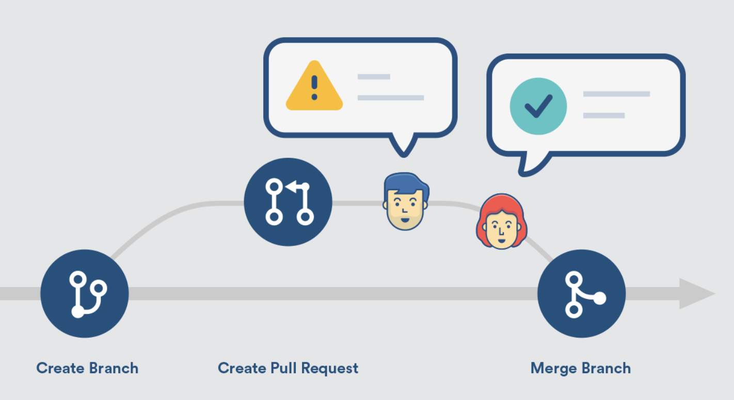
Best Practice Two:
Mandate Code Integrity and Review Security controls must ensure that all code entering the repository is verified, reviewed, and traceable to the author.
• Code Signing: All developers should possess their own PGP key. It is straightforward to configure all commits to version control to be signed using open-source tools like gpg and git. • Artifact Signing: All packages created by the CI process must be signed, and their cryptographic hash should be recorded in the centralized logging service for audit purposes. • Peer Review as Control: View pull requests as a control mechanism, instead of relying solely on separation of duties. • Expert Review: For higher risk areas, such as database changes or business-critical components with poor automated test coverage, require further review from a designated subject matter expert!
Photo by Pixels

Slide 5

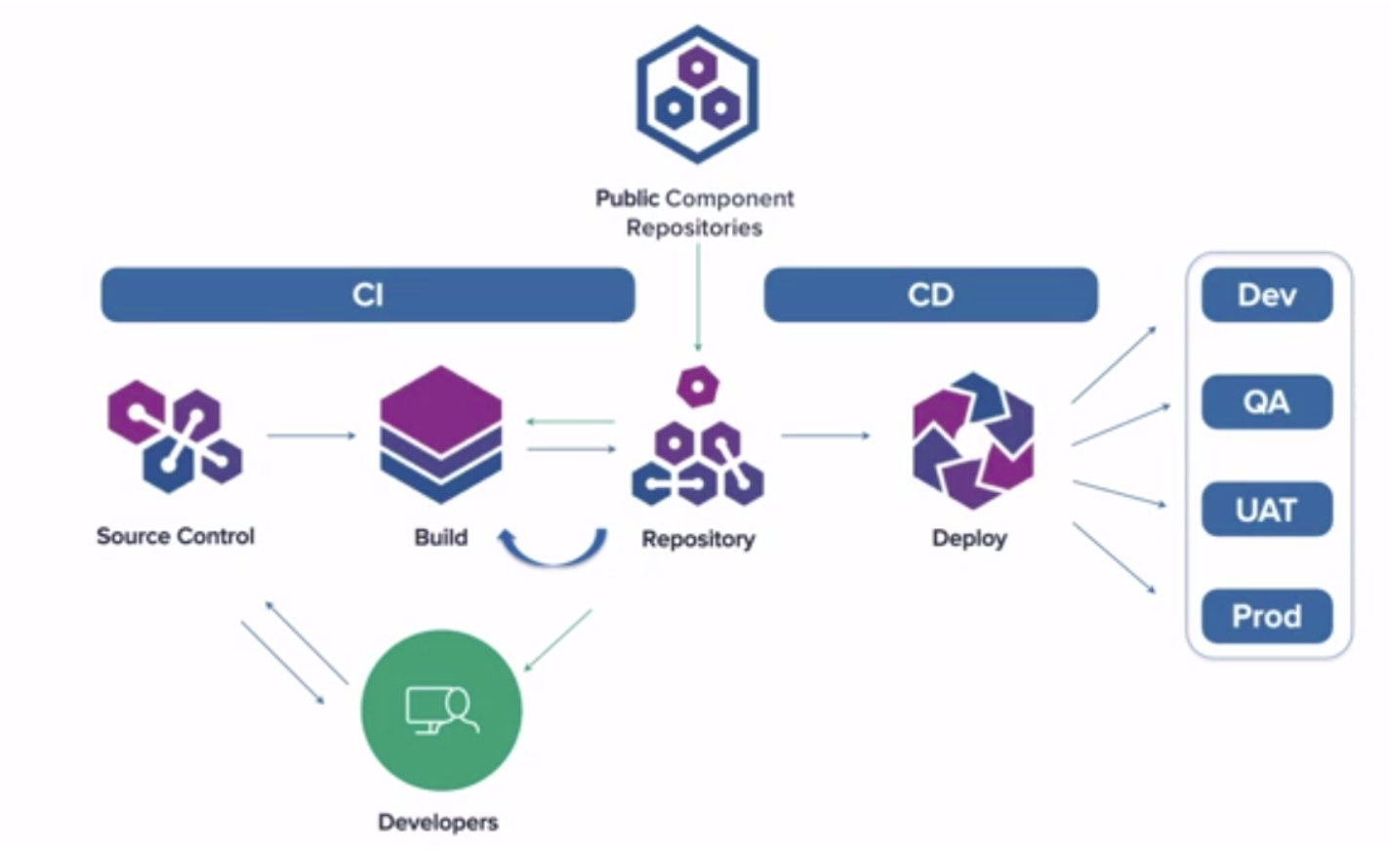
Best Practice Three :
Control the Software Supply Chain
The repository must act as a gatekeeper to mitigate risks associated with third-party and open-source dependencies.
• Dependency Source Control:
It is essential to ensure that dependencies are drawn only from within the organization’s source control repository or package repository. This prevents external compromise through the software supply chain.
• Automated Scanning (Dependency Scanning): Perform normally at build time. This inventories all dependencies for binaries and executables to ensure components are free of vulnerabilities or malicious binaries.
• Recommended Tools: Tools like OWASP Dependency-Check and Sonatype Nexus Lifecycle can assist in ensuring dependency integrity
• Stay Current: The best security patching strategy is often seen as simply remaining current on all dependencies, as publication of vulnerabilities (CVEs) often follows the release of a fixed version.
Photo by Pixels

Slide 6
Best Practice Four: Integrate Automated Security Testing!
Automate security tests so they run alongside all other automated tests in the deployment pipeline, ideally upon every code commit.
This process provides developers with fast feedback to quickly detect and correct security problems as part of their daily work
Test Type | Description | Integration Point
Static Analysis (SAST) | Inspects code for potential runtime behaviors, coding flaws, back doors, and malicious code. | Commit/Build Stage in the deployment pipeline.
Dependency Scanning | Checks components and libraries for known vulnerabilities. | Build Stage
Dynamic Analysis (DAST) | Tests running applications, focusing on sad paths, not only the happy paths (security-related error conditions) and mimicking malicious third parties. | Automated Functional Testing phase.

Slide 7

Effective repository security practices facilitate compliance and auditing requirements:
• Centralized Visibility: The repository acts as an omni-directional communication mechanism. Development, Operations, Infosec, and potentially auditors should all be aware of changes being made.
• Automated Audit Evidence: Automation ensures that necessary evidence is automatically generated as part of daily work. This traceability can link a production deployment back to the changes in version control and the corresponding work tickets.
• Mitigating Fraud Risk: Controls like continuous inspection of code check-ins and code review provide necessary reassurance about work quality and can effectively mitigate the risks traditionally addressed by separation of duty
Outcome: Compliance and Traceability

Slide 8
Summary : The ultimate goal is to ensure that security is baked into the code and the development process, rather than being inserted later as a bottleneck
Goals | The Overall Best Practice in Shared Repository
Control & Governance | Implement a single, centralized source repository encoding organizational standards and security expertise into reusable artifacts.
Integrity & Authorship | Mandate code signing (PGP keys) for all commits and artifact signing for all packages.
Quality Assurance | Integrate automated security testing (static/dependency scanning) directly into the CI pipeline to provide immediate, actionable feedback.
Risk Mitigation | Enforce peer review by security experts for high-risk changes, and control the software supply chain by sourcing dependencies only from internal repositories.

Slide 9
Reference:
Kim, G., Humble, J., Debois, P., Willis, J., & Forsgren, N. (2021). The DevOps handbook, second edition: How to create world-class agility, reliability, & security in technology organizations. IT Revolution Press, LLC.

